Slide 1
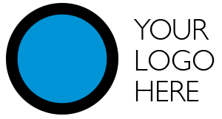
YOUR COMPANY NAME
PHONE: EMAIL:

Slide 2
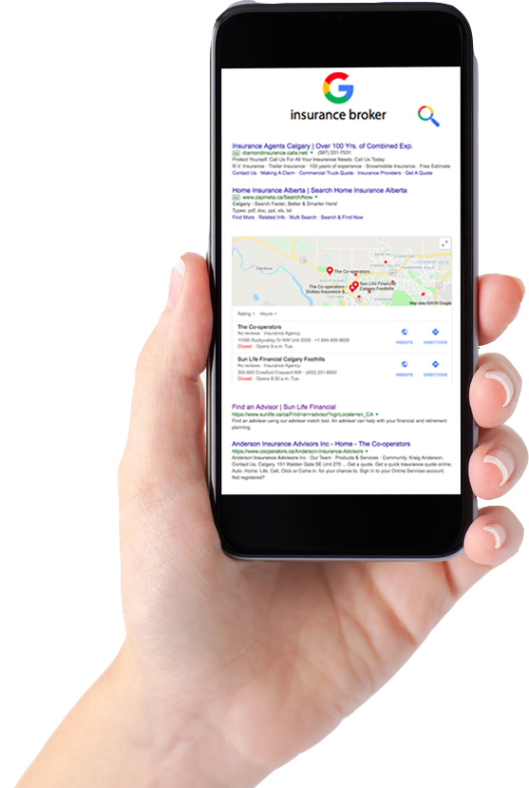
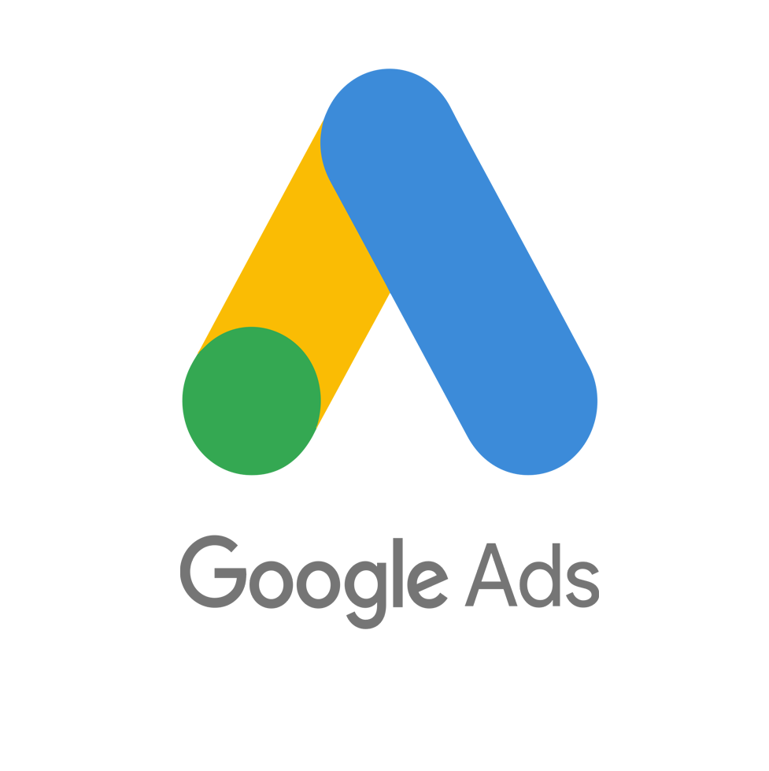
ABOUT GOOGLE ADS
Google Ads are displayed to potential customers while they are actively searching for products or services
Google Ads are given higher priority on search results pages
Making them the most effective way to reach new customers

Slide 3
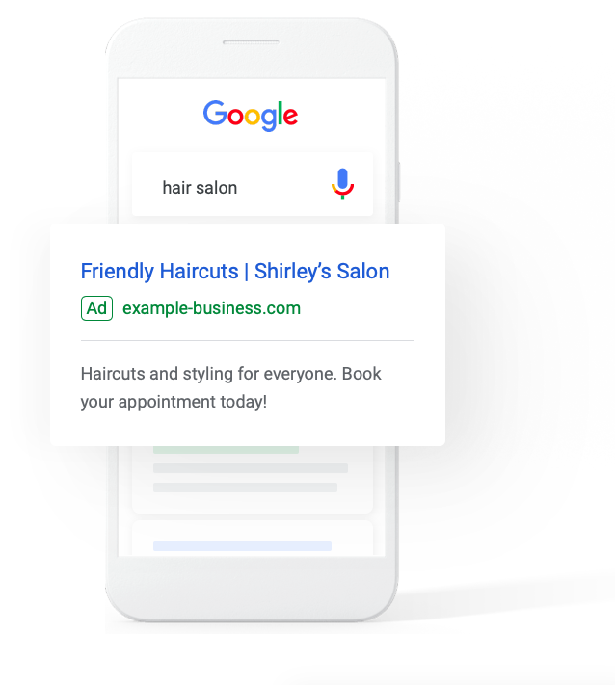
REACH THE RIGHT PEOPLE, IN THE RIGHT PLACE,
AT THE RIGHT TIME
Google Ads are shown to engaged consumers while they are actively searching for the specific products or services you provide.
Ads give free branding awareness, and you only pay when engaged consumers click through and engage with you.

Slide 4
THE BIG GUYS ALL USE GOOGLE ADS -
BECAUSE THEY WORK
The average business sees a 2-25x return for every $1 spent on Google Ads. This is better than any other advertising medium out there today
But competing with the resources and budgets of larger competitors can be a struggle for small businesses

Slide 5
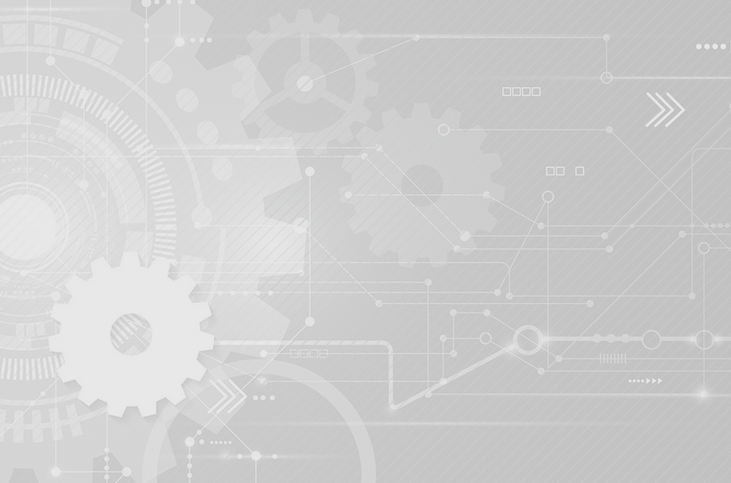
AUTOMATION OPENS UP THE DOOR FOR SMALL BUSINESSES
WITH AUTOMATION YOU:
SAVE TIME | automation handles all aspects of setup and monitoring of your campaign, allowing you to spend your valuable time on better things
SAVE MONEY | with automaton most of your budget goes into your actual ad spend, not to high consulting or management fees

Slide 6
HOW IT WORKS
1
You tell us a little bit about your business
2
We create Google Ads tailored to your business
3
We optimize your ads to fit your budget and target audience
4
We continuously monitor and improve your campaign over time

Slide 7
START GETTING NEW CUSTOMERS FROM AUTOMATED GOOGLE ADS
With low budget starting points, small businesses can reap the benefits of Google Ads like their larger competitors
YOUR COMPANY NAME
PHONE: EMAIL:
Try Automated Google Ads for your business and start receiving new customers in your target market
FAST, EASY SETUP
WORKS 24/7/365

